Slide 1
Carlo Pescio An overly simple, C++ idiomatic pattern language for message-based product families
overly simple
C++ idiomatic
pattern language
message-
based product families

Slide 2
Time-proven
Used many times over ~20y
Used in small (PIC 32 w/ KB of RAM) embedded systems
Used in “big” (i7 w/ GB of RAM) embedded systems
N x 100K units around the world using this stuff ☺

Slide 3

good design??
Principles
Patterns
Dogma
Paradigm
Method
Technology
Forces -> Response

Slide 4

Product family

Slide 5
Product
a subset of a “feature set”
Defined extensionally : P = { F₁, …, F_{p} }
Most likely dynamic over time
Products can be standard or custom
| P | is “relevant”

Slide 6
Product family
a set of products
Defined extensionally : F = { P₁, …, P_{f} }
Dynamic over time
| P_{i} ∩P_{j} | ≈ ∑| P_{i} |
_____
f
| F | is “relevant”

Slide 7
Approaches
Many, but mostly:
Full-blown + configuration
Selected features only

Slide 8
“expansive force”
“good response”
New feature -> New code
Grow / shrink product
include / remove file
Add product to family
Choose file set
Family growth
Product growth
Feature set growth

Slide 9
“bad response”
Custom code, “feature aware” code for each product
|F| “relevant” => lots of custom artifacts
|P| “relevant” => each artifact is “relevant”
| P_{i} ∩P_{j} | ≈ ∑| P_{i} | => custom yet highly similar ________ f
|F| and |P| unstable and usually growing => maintenance cost
Common traps: switch/case, pattern matching, case classes, sum types, builders, … (anything “enumerative” in nature)

Slide 10
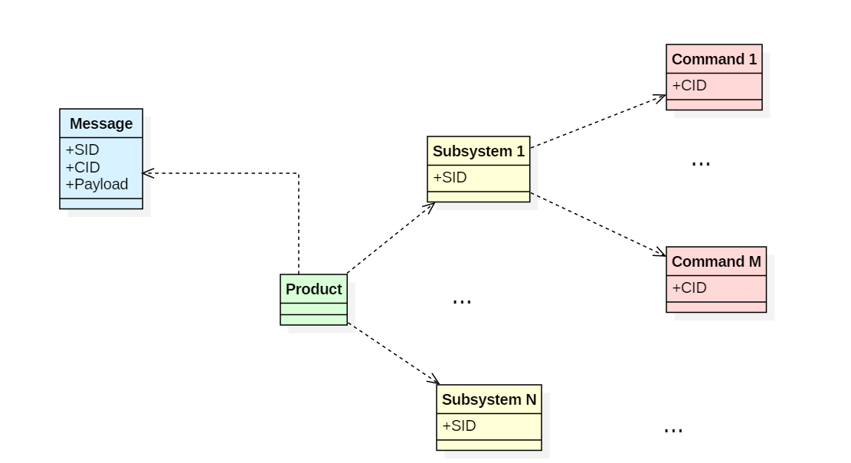
Context

Slide 11
The ugliness
class MessageHandler // or Dispatcher
{
void handle( const Message& m )
{
switch( m.getSubsystem() )
{
case SS1 :
{
switch( m.getCommand() )
{
case CMD1:
{
// now what?
}
}
}
}
}
}
Ugly naming
Can’t share among products
Maintenance black hole
Same issue with pattern matching

Slide 12
Half-hearted
A “main”
A “factory”
still the same problem / shape
A “configuration file”
- not idiomatic (reflection?)
- better for “full-blown”
- [ dynamic loading not available everywhere, e.g. PIC 32]
I know, I’ll use a map of commands!
MessageHandler
Message -> SID,CID,params
CmdMap : (SID,CID) -> Command
Command -> Execute( params )
Ok, who is filling the map?

Slide 13
A 1st idiomatic notion
Self-instantiating object
Avoid the common trap of a single artifact which knows many objects.
Add a class (artifact) -> Get an object (run-time)
The object is born before main is executed. Avoids threading issues as well.
Idiomatic: can’t do this in Java or C#, they only got lazy statics.

Slide 14
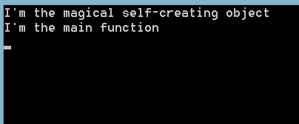
Code: overly simple
class SelfCreating
{
private:
SelfCreating()
{
std::cout << "I'm the magical self-creating object" << std::endl;
}
static SelfCreating instance;
};
#include "SelfCreating.h"
SelfCreating SelfCreating::instance;
int main()
{
cout << "I'm the main function" << endl;
return 0;
}

Slide 15
The self-creating singleton
Useful outside this restricted application.
The C++ idiomatic solution to the real hard question:
who creates the creator? << it creates itself (seems just right too)
See:
prototype
abstract factory
factory method
etc.

Slide 16
Bring in some domain
A command is a self-instantiating, stateless singleton
Self instantiating: no one needs to “know all the commands”
Commands register themselves with a catalog reversing the dependency
Being stateless is not strictly necessary, but it’s often the right choice commands are ok with being stateless anyway

Slide 17
A singleton (booooo!!!)
Stateless, immutable, single function -> it’s a function (ooohhhhh!!!!!)
Added Value: the singleton constructor will register the function in a catalog that’s the magic functions can’t do
But the catalog must be a singleton too, and born before (ain’t that difficult?)

Slide 18
Commands & subsystem
Being realistic: same command code in different susbsystems should be ok
Therefore: a command catalog for each subsystem
Therefore: the [concrete] command should know its own subsystem it’s OK, it’s the opposite that we do not want (ss->cmd)

Slide 19
Code: simple enough
class Command
{
public:
virtual ~Command()
{
}
virtual void Process(
const char* payload) = 0;
};
template<class SS, class CMD> class RegisteredCommand : public Command
{
protected:
RegisteredCommand()
{
CommandCatalog<SS::SID>:: RegisterCommand(CMD::CID, instance);
}
private:
// eager singleton - MUST be eager
static CMD instance;
};
template<class SS, class CMD> CMD RegisteredCommand<SS,CMD>::instance;
CRTP (2nd Idiomatic notion)

Slide 20
Code: simple enough
class StartEngineCMD : public
RegisteredCommand< EngineSS, StartEngineCMD >
{
public:
static const int CID = 2;
void Process(const char* payload) override;
private:
friend class RegisteredCommand< EngineSS, StartEngineCMD >;
StartEngineCMD();
};

Slide 21
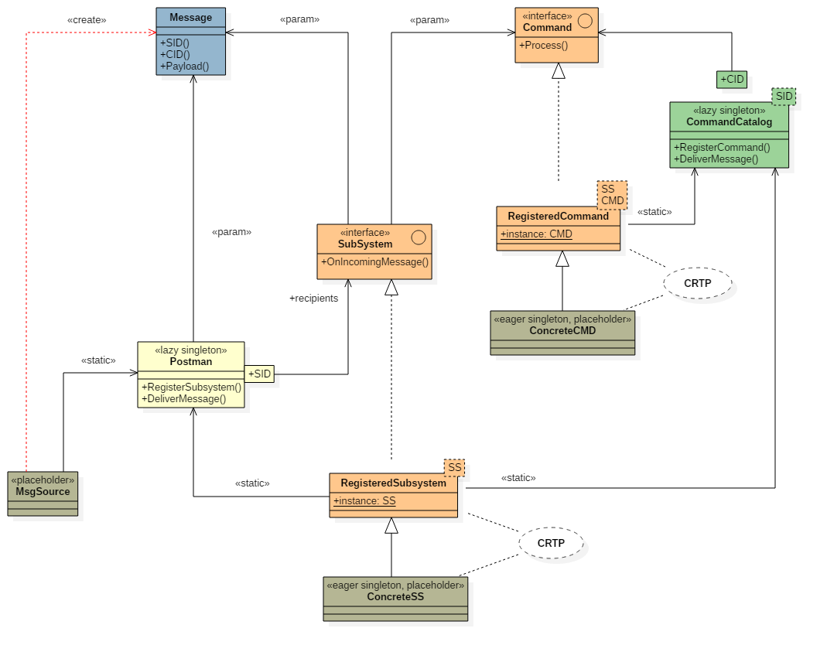
UML diagram (in 2017 ?! :-)
Type erasure

Slide 22
A 3rd idiomatic notion
A command catalog is a stateful, semi-immutable lazy singleton
Lazy: simplest way to solve the initialization order problem commands are eagerly created before main is started, the first command creates the catalog as well
The catalog is read-only / immutable when the main is started all mutations happen in a single thread before main is called thread-safe, read-only access after that (don’t worry – live happy)

Slide 23
Code: again, overly simple
template< int SID > class CommandCatalog
{
public:
static void RegisterCommand(int CID, Command& c)
{
auto& r = Recipients();
assert(r.find(CID) == r.end());
std::pair< int, Command& > p(CID, c);
r.insert(p);
}
private:
static std::map< int, Command& >& Recipients()
{
// lazy singleton - MUST be lazy
static std::map< int, Command& > recipients;
return recipients;
}
};
// later
// static bool DeliverMessage( // const Message& m)

Slide 24
The haiku
The lazy singleton is fully constructed before the eagerest singleton
惰

Slide 25
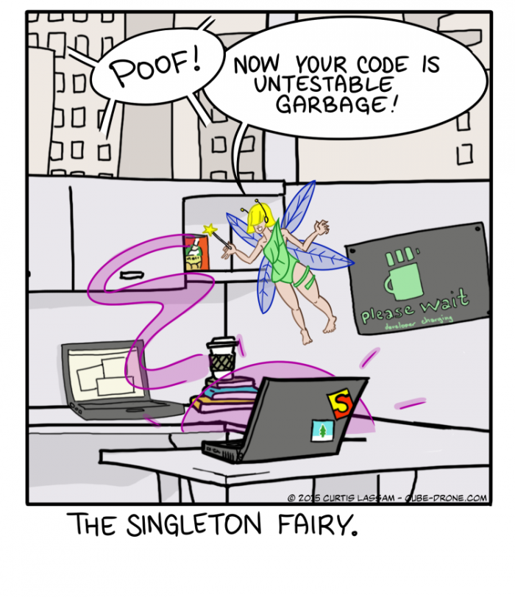
Mocking commands?
Assuming it makes sense – depends on the application sometimes mocking hardware resources is a better option
If you want a “test build” vs. a “standard build” trivial, just define mock and std commands, use the makefile
If you want to choose at runtime create both, register both, enable one [with a command] one more template parameter will help ☺

Slide 26
Rinse and repeat
Subsystems are self-creating singleton[s] too
Subsystems register themselves with a postman / catalog no one needs to “know all the subsystems”
The postman is a lazy singleton as well
See the symmetry: Command<->CommandCatalog, Subsystem<->Postman sort of, there is 1 catalog per subsystem, but ok

Slide 27
there : )

Slide 28
Subsystems responsibilities
Defines its own address (SID, this is in the sample too)
Owns exclusive HW resources (e.g. a RS485, some I/O, etc.)
Usually offers some logic to its own commands
Is usually stateful / mutable: mirrors the state of hw devices

Slide 29

A mutable singleton!
- In the sample code, it’s all synchronous, but in a real system, a SS will probably have its own message queue and a thread. N SS could share 1 thread if reasonable.
- Commands belonging to a SS will be executed in the SS thread. So even if they call back into the SS, it’s still single-threaded. We never need to synchronize (except [maybe] the command queue).
CMD1 in SS1 can send messages to SS2, using the Postman So it’s also an internal communication channel.
So, a subsystem is an actor (oooohhh).
What about mocking?? (same as commands…)

Slide 30
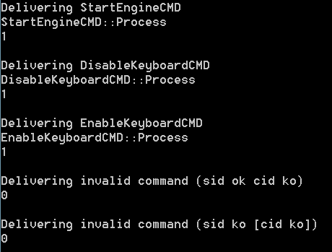
A little more code
bool Postman::DeliverMessage(const Message& m)
{
auto r = Recipients();
auto i = r.find(m.SID());
if (i != r.end())
return i->second.OnIncomingMessage(m);
return false;
}
static bool DeliverMessage(const Message& m)
{
auto r = Recipients();
auto i = r.find(m.CID());
if (i != r.end())
{
i->second.Process(m.Payload());
return true;
}
return false;
}

Slide 31
Variations
Protocol: encoding, ack/nak, synchronous vs asynchronous answer, etc.
Threading: synchronous, 1 thread per SS, 1 thread * N SS, N thread * 1 SS
Queuing: selective coalescence or not.
Execution: 1 active command, N active commands, background activity
Substitution: Mocking commands, Activable commands, etc.
“Details”: splitting payload parsing and execution (stateful commands, cloning).

Slide 32
Why “a pattern language”
“Many patterns form a language”
Trying to generalize will turn this short code into the usual abstract monster
File Name | Lines | Statements | Average Statements per Method
Command.h | 12 | 3 | 0.0
CommandCatalog.h | 41 | 20 | 4.0
Message.h | 31 | 10 | 0.8
Postman.cpp | 33 | 17 | 3.7
Postman.h | 15 | 7 | 0.0
RegisteredCommand.h | 18 | 7 | 1.0
RegisteredSubsystem.h | 24 | 10 | 1.0
Subsystem.h | 14 | 4 | 0.0

Slide 33
The abstract monster
Policies everywhere
Parameters everywhere
N times longer to account for any possible variability
Names far removed from domain terminology
Steep learning curve
Cross maintenance
VS. understand the Pattern Language ad adapt on your system

Slide 34
PhysicsOfSoftware.com
Notes on Software Design, Chapter 12: Entanglement http://www.carlopescio.com/2010/11/notes-on-software-design-chapter-12.html
Notes on Software Design, Chapter 13: On Change http://www.carlopescio.com/2011/02/notes-on-software-design-chapter-14.html
Notes on Software Design, Chapter 14: the Enumeration Law http://www.carlopescio.com/2011/02/notes-on-software-design-chapter-14.html
On Growth and Software (nCrafts, Paris, May 2016) Video: http://videos.ncrafts.io/video/167699028

Slide 35








Thanks to the sponsors!
Italian C++ Conference 2017 #itCppCon17

Slide 36

Brain-Driven Design
Design your software by squeezing your brain, not by following trends
carlo.pescio@gmail.com

